Slide 1
Realizable Accessibility Reevaluating the Reliability of Public Transit Accessibility
Luyu Liu
2021/11/17

Slide 2
What is accessibility?
Accessibility is your ability to reach different places
Example: How far can you go in 30 minutes?
Example: How many jobs you can commute to by bus?
Accessibility is your freedom to move, which public transit usually lacks

Slide 3
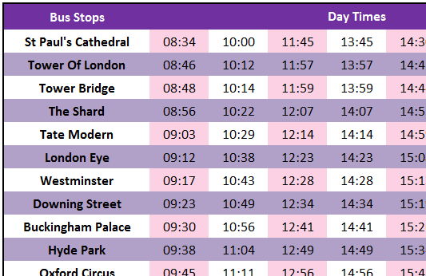
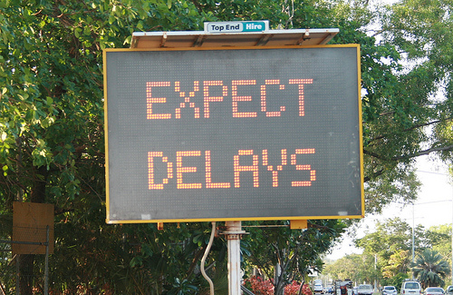
Why do we fail transit accessibility?
In short, we do not measure it right: it is not reliable
Traditional studies used scheduled data
Scheduled data is not reality
Delay or early arrival can happen (a lot!)
Source Source

Slide 4
So just measure the actual time!
Why don’t we just change the scheduled time to the actual real-time time?
Yes, people did:
Wessel, Allen, Farber (2017) and Wessel and Farber (2019) retrospectively calculate the real-time accessibility
They found that the retrospective real-time accessibility are significantly different from the scheduled accessibility
Is it the end of the discussion?

Slide 5
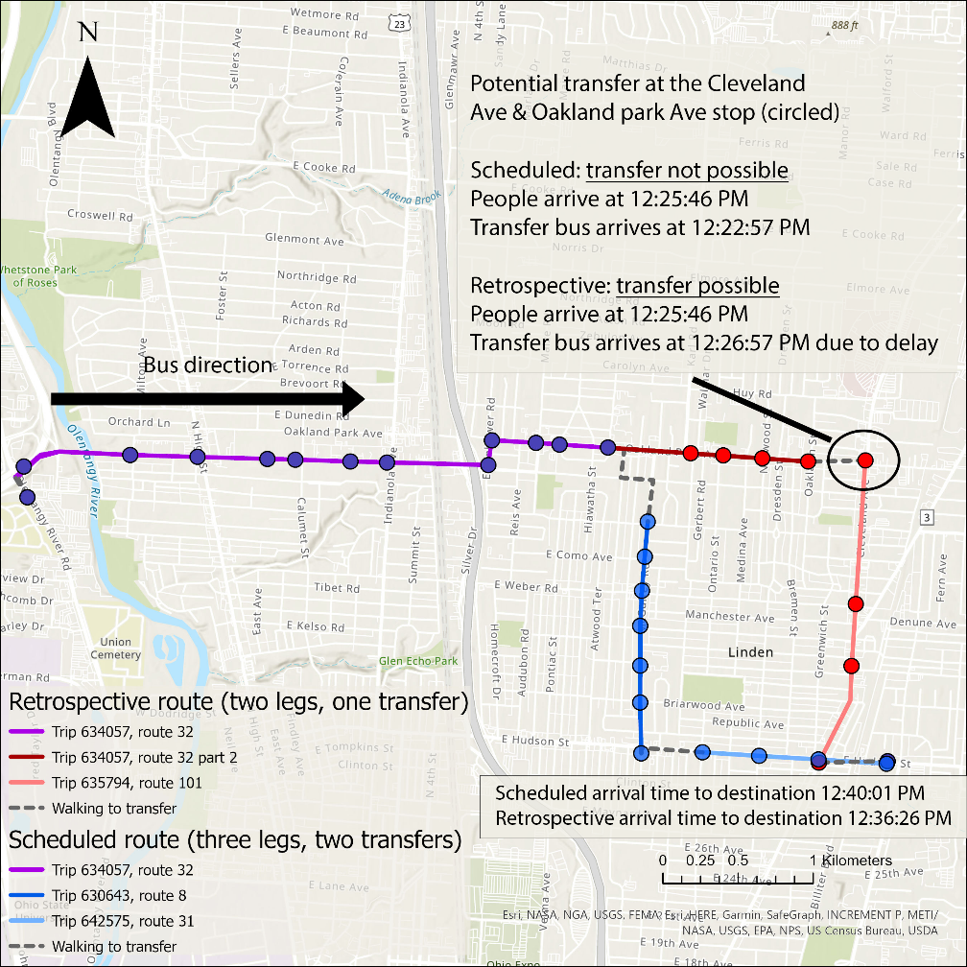
But can you actually do it?
Short answer: you cannot. Because you must predict the future.
No one can tell buses’ actual arrival time before taking the bus
Transfer is possible retrospectively but cannot foresee it
What you planned can be different from what you take

Slide 6
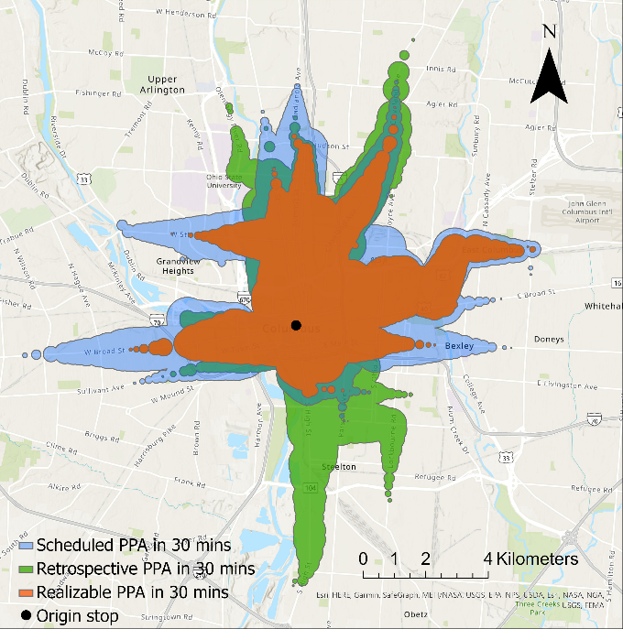
Realizable accessibility
It is two-step.
First plan with scheduled times, which are available beforehand.
Then implement with actual times.
Just like what human does.
It is more conservative.
Realizable accessibility has smallest reachable area in 30 minutes

Slide 7
How unreliable public transit can be?
Unreliability: the difference between realizable and scheduled accessibility
It is the degree of broken promise
Example: How far you can go from Columbus downtown in the real world (orange) versus in the schedule (blue)

Slide 8
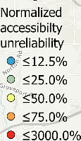
How does unreliability change?
Each point is a people trying to reach as far as possible
Color show unreliability
Unreliability start from city center, spread to the suburban
For more practical time budget (15 – 30 minutes), accessibility in the city center is much more unreliable

